Slide 1
Perform matrix multiplication and find eigen values and eigen vectors using tensorflow.
Deep Learning Practical - 2

Slide 2
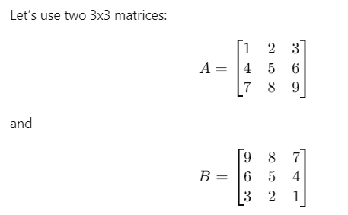


Slide 3

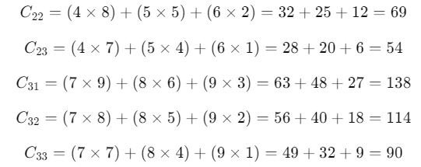
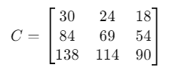

Slide 4
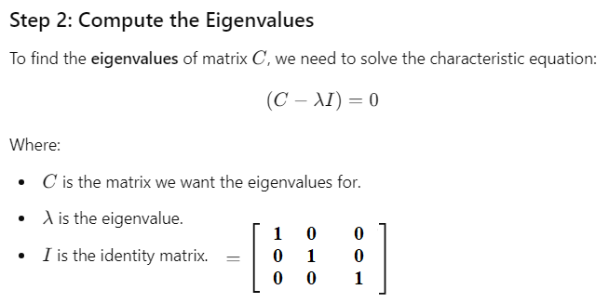

Slide 5

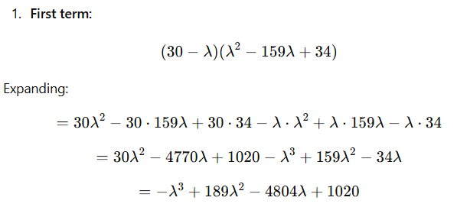

Slide 6
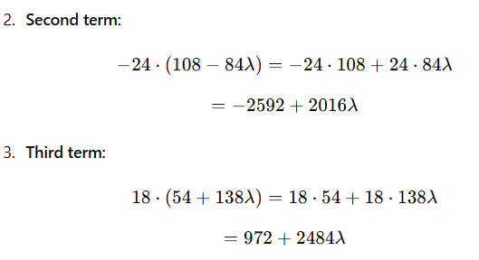
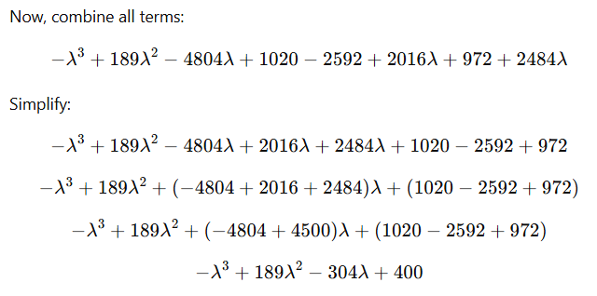

Slide 7



Once you have the eigenvalues, you can easily find the eigenvectors corresponding to each eigenvalue.

Slide 8

Here comes “tensorflow” which is mainly used in deep learning related projects for large computation eg: Finding eigen vectors and eigen values.
TensorFlow is an open-source deep learning framework developed by Google that is primarily used for large-scale computation tasks, especially in the domain of deep learning.

Slide 9







Slide 10
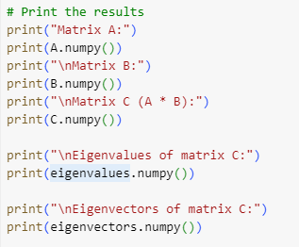
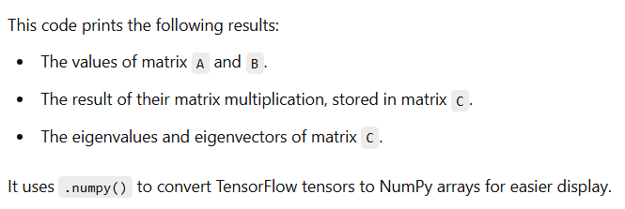

Slide 11
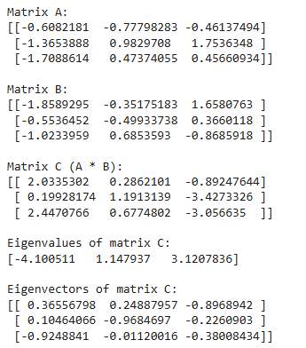
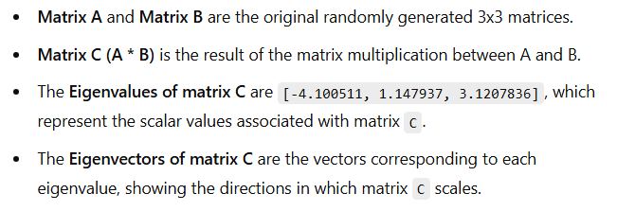

Slide 12



In deep learning, eigenvalues and eigenvectors play an important role.
For example:-

